Slide 1
Digital Portfolio
STUDENT NAME:Aswath S
REGISTER NO AND NMID: 2428C0465,
A63E9CA0D083A0C8C664FAA317D39D42
DEPARTMENT: Bsc AI & ML
COLLEGE: KPR College of Arts & Science, Bharathiar University

Slide 2
PROJECT TITLE
Scholarship/competition portfolioWebsite

Slide 3


AGENDA
Problem Statement
Project Overview
End Users
Tools and Technologies
Portfolio design and Layout
Features and Functionality
Results and Screenshots
Conclusion
Github Link
3/21/2024 Annual Review

Slide 4

PROBLEM STATEMENT
Many students face difficulties in effectively showcasing their academic achievements, skills, extracurricular activities, and personal strengths while applying for scholarships and competitions.
Existing application processes often rely on plain resumes or static documents that fail to capture the student’s overall profile in an engaging and organized manner.
This lack of a structured and visually appealing portfolio reduces their ability to stand out among peers, limiting opportunities for recognition, funding, and career growth.

Slide 5

PROJECT OVERVIEW
The Scholarship/Competition Portfolio project aims to create a digital platform that enables students to professionally present their achievements, skills, and experiences in a well-structured and visually appealing format.
Unlike traditional resumes, this portfolio integrates academic records, extracurricular activities, leadership roles, community service, certifications, and project showcases into one unified profile.

Slide 6

WHO ARE THE END USERS?
- Students
- Scholarship Providers
- Recruiters/Educational Institutions
- Teachers/Mentors
- Career Counselors / Mentors

Slide 7

TOOLS AND TECHNIQUES
- HTML5
- CSS3 (3D Effects, Gradients)
- JavaScript (Interactivity)
- GitHub Pages (Deployment)
- VS Code (Development)

Slide 8
POTFOLIO DESIGN AND LAYOUT
Modern, Clean Layout with structured sections for smooth readability
Sections Included: Home, About Organizer, Events Showcase, Achievements, Contact
Event-Themed Colors: Gold (highlights, headings) & Dark Blue (backgrounds, buttons)
Interactive 3D Hover Effects on event/project cards to make showcases engaging
Sticky Navigation Bar for smooth scrolling across sections
8

Slide 9
FEATURES AND FUNCTIONALITY
- Event showcase with highlights
- Interactive 3D hover cards
- Responsive and mobile-friendly layout
- Sticky navigation with smooth scrolling
- Contact form and collaboration links

Slide 10
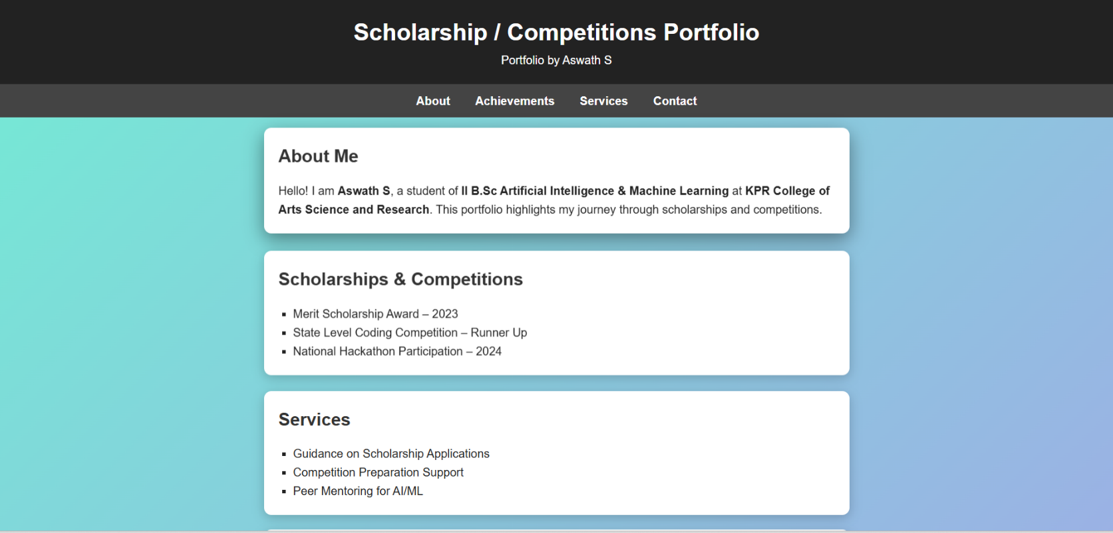

RESULTS AND SCREENSHOTS
Results:
Enhanced Student Visibility
Improved Selection Opportunities
Professional Showcase of Achievements
Screenshot:
3/21/2024 Annual Review
10

Slide 11
CONCLUSION
The Scholarship/Competition Portfolio provides students with a structured and professional platform to present their achievements and skills. It enhances visibility, builds confidence, and increases opportunities for recognition in scholarships and competitions.
By offering a digital, organized, and dynamic showcase, the portfolio ensures that students stand out and achieve greater academic and career success.
11

Slide 12
Git hub Link: Portfolio Repository: https://github.com/aswathsenthilkumar1705-ops/portfolio.git

